Slide 1
Emerging Market Risks
Classification, Definitions, And Management

Slide 2
Emerging Markets: Higher Returns For Higher Risks
Emerging markets are fast-growing markets
Higher-growth usually means higher equity returns
And higher risks associated with a fluid political structure, incomplete financial regulation, a small trading float, etc.

Slide 3
A Long List Of Risks
Political Risk
Currency Risk
Liquidity Risk
Company Risk
Broker Risk
Settlement Risk
Custodian Risk
Operational Risk
Market Risk

Slide 4
What’s Political Risk
The most serious emerging market risk.
The impact of politics on markets, including nationalization of foreign assets, which can be catastrophic for investors (e.g., Venezuela).
Popular movements, laws, and actions that can destabilize a country or the world economy, inflicting big losses to investors
Internal and external shocks, e.g., massive demonstrations in Egypt, refugees crossing from Turkey to Greece.
in a global economy, political risks spread like a fire across countries, as markets grow interdependent
Trouble in Venezuela can quickly spread to Colombia, Brazil and Argentina and even Southeast Asia
Trouble in China can affect Brazil and Nigeria, which supply resource/energy to China.
Source: Ian Bremmer, Managing Risk In An Unstable World, HBR

Slide 5
More Examples Of Political Risks
The failed military coup in Turkey—it prompted downgrades by credit agencies.
Luis Inacio Lula da Silva’s election as Brazil’s president—he has been compared to Hugo Chavez.
The impeachment of Brazilian President Dilma Rousseff
The 2003 revolution in Georgia.
Terrorist attacks in hotels in Turkey and North Africa.
Nigeria’s failure to pass the Petroleum Industry Bill (PIB).
Russian sanctions
Scottish Referendum
Brexit
Terrorist attacks in France.
Colombian vote on ending the war.
Change in American policy towards Pakistan

Slide 6
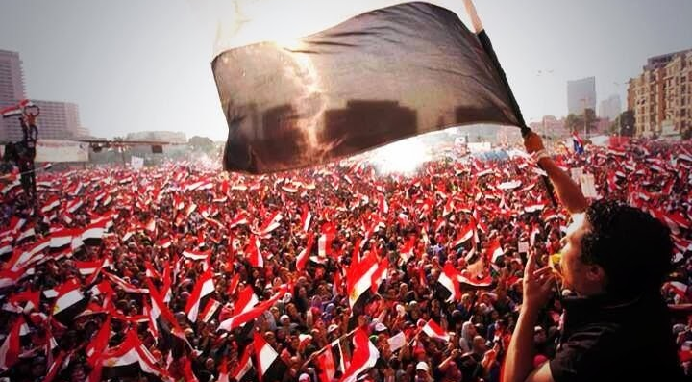
Egyptian Uprising
https://popularresistance.org/islamists-out-military-in-arabspring/

Slide 7
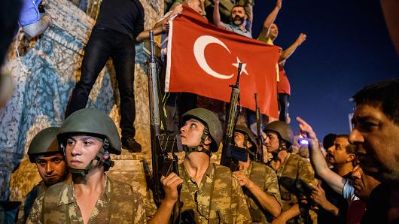
Turkish Military Coup
http://www.cnbc.com/2016/08/05/turkeys-economy-under-spotlight-after-failed-coup.html

Slide 8
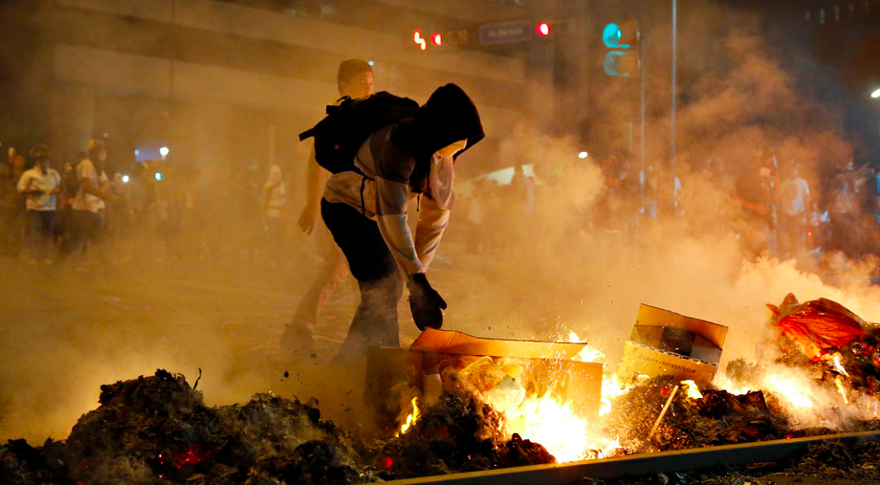
Venezuela Riots

Slide 9
Brexit

Slide 10
How to Measure Political Risk
By nature, political risk is hard to quantify and measure.
The best it can be done is to use proxy variables, such as youth unemployment and imprisonment rates to construct political risk indices.
The Eurasia Group, for instance, is using 20 composite indicators, which include the soundness of government, economy, security, etc.
https://www.eurasiagroup.net/
http://www.aon.com/2016politicalriskmap/
http://www.coastlightcapital.com/heatmap-g20-indicators-2/
https://www.prsgroup.com/category/risk-index
https://hbr.org/2005/06/managing-risk-in-an-unstable-world

Slide 11
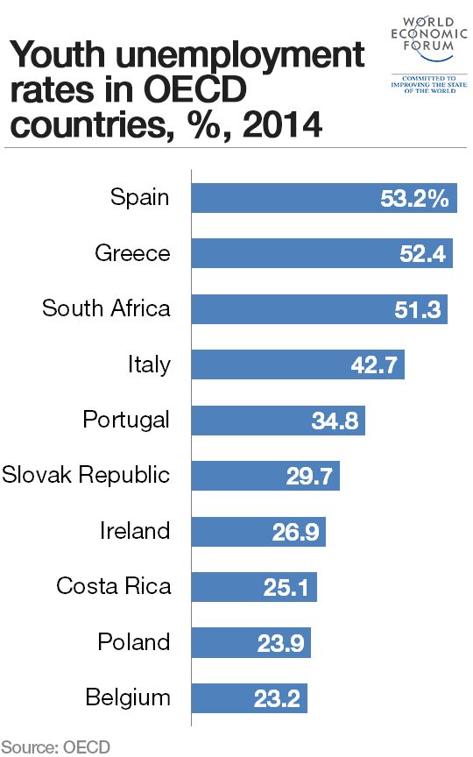
Countries With High Youth Unemployment Rates
https://assets.weforum.org/wp-content/uploads/2015/07/YouthUnemploymentRatesOECD.png

Slide 12
Also Check The “Life Satisfaction” Index
Published by Gallup
https://news.gallup.com/opinion/gallup/236357/indians-life-satisfaction-goes-bust-economy-booms.aspx
A big dip in the indicator is a sign of rising political risk ahead (e.g., Egypt and Ukraine)
https://news.gallup.com/opinion/gallup/236357/indians-life-satisfaction-goes-bust-economy-booms.aspx
https://news.gallup.com/opinion/gallup/220712/country-ready-change.aspx?g_source=link_newsv9&g_campaign=item_236357&g_medium=copy

Slide 13
How To Manage Political Risk
Get early and accurate information on political developments.
Use political analysis to detect seeds of upcoming instability or find a silver linings in political chaos.

Slide 14
The Difference Between Economic And Political Analysis
Economic analysis tells you what a country can do, e.g., whether it can pay its debt
Political analysis tell you what a country will do, e.g., whether it will pay its debt.
Political analysis can further tell you how a specific leadership change would affect a country’s stability or instability.
Would-be radical leaders, for instance, turn moderate after they assume office, e.g., Lula (2003( in Brazil, Papandreou (2001 in Greece.

Slide 15
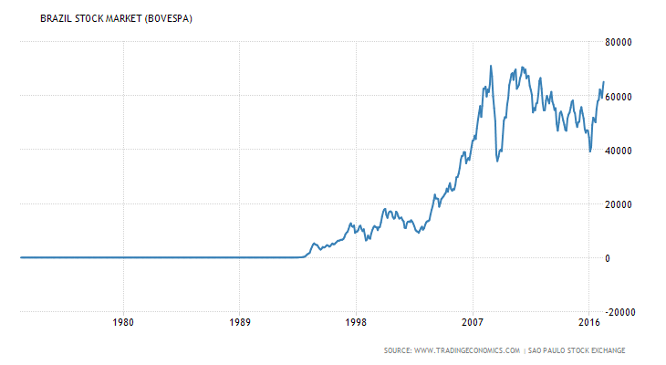
Brazilian Stocks Soar During “Socialist” Lula
Lula’s term1 January 2003 – 1 January 2011

Slide 16
Political Analysis
Can identify clashes between the capital of a country and its regions, e.g., Thailand.
Clashes between Federal Government and states (e.g., Nigeria).
Can identify clashes between an open economy and a closed political system, e.g., China.
Openness may cause what appears to be chaotic situations, but they act as diffusion mechanisms,, e.g., the 2000 election deadlock in the US, the 2012 Greek debt crisis.
Closeness may create a sense of stability, but it can lead to explosive situations.

Slide 17
Political analysis leads to three questions:
How likely is it that a shock will occur?
When will it probably occur?
How high are the stakes if it does?
The highest risk is when shocks are likely, imminent and have widespread consequences.

Slide 18
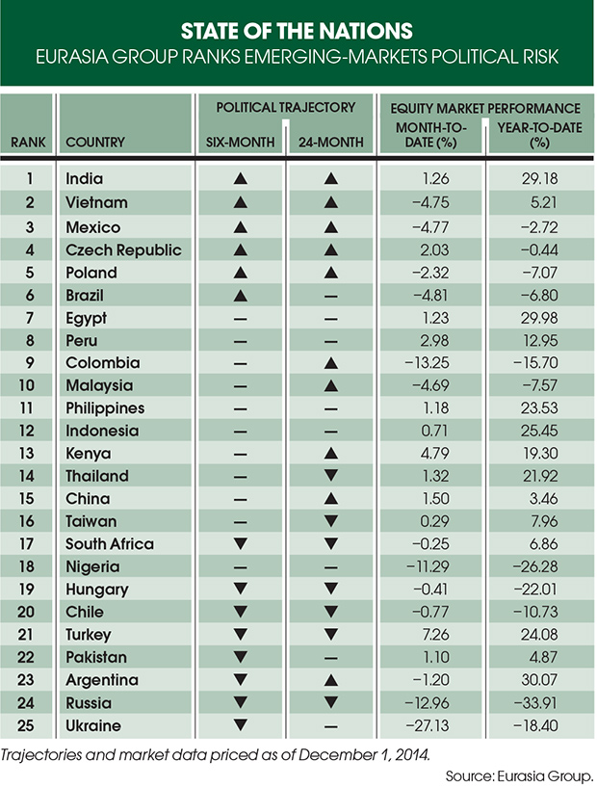
GEM And Political Risk

Slide 19
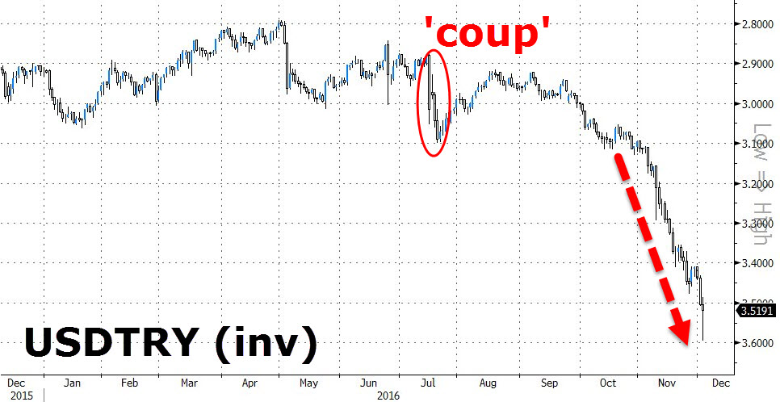
Turkish Equities Drop Sharply After The ‘Coup’
http://www.zerohedge.com/sites/default/files/images/user5/imageroot/2016/11/29/20161202_TRY.jpg

Slide 20
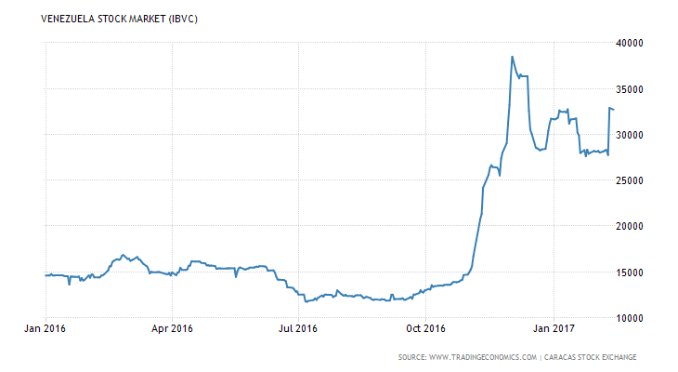
Venezuelan Stocks

Slide 21
What’s Currency Risk
The losses associated with fluctuations in the national currency.
Like the 1994 Tequila Crisis
The 1997 Asian currency crisis
It can be magnified by the “yield trade”
Borrowing on the short end of the yield curve to buy the long end.

Slide 22
Types of Currency Risks
Portfolio Risk—risk associated with operations denominated in foreign currencies.
Structural Risks—risks associated with cash flows denominated in different currencies (e.g., revenues in dollars, costs in yen or euros).
Transaction Risks—risks associated with timing of contractual commitment and execution.
Read more: http://www.mckinsey.com/business-functions/strategy-and-corporate-finance/our-insights/getting-a-better-handle-on-currency-risk

Slide 23
A Major Source Of Currency Risk Is Interest Rate Risk
The prospect of interest rates rising in developed countries.
As it was the case back in 2013 when US interest rates edged higher.
Indonesia, Brazil, South Africa and Turkey’s currencies have been most vulnerable, losing close to 15% of their value.
http://money.cnn.com/2014/01/30/investing/emerging-markets-fragile-five/?iid=EL

Slide 24
The 10year Yield Spike--2013 And Now

Slide 25
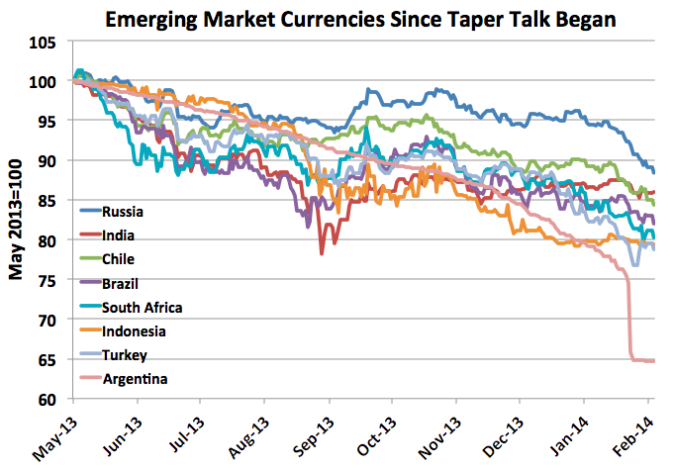
Fed’s 2013 “Taper” And Emerging Market Currencies
http://economeka.blogspot.com/2014/02/emerging-markets-currency-depreciation.html

Slide 26
Rising US yields crush weak emerging market currencies

Slide 27
Argentina peso—another weak currency crushed

Slide 28
Even the ”Mighty” Yuan

Slide 29
A Stronger Dollar Is Now A Big Threat For Emerging Markets
https://en.wikipedia.org/wiki/U.S._Dollar_Index#/media/File:US_Dollar_Index_from_Stooq_dot_com.png
Most emerging markets
Emerging market economies that borrowed in dollars in 2009-12 are facing higher payments in local currencies in the last three years.
American investors who purchased emerging market securities over this period are facing double losses, as they try to repatriate their funds (eg., Brazil).
http://www.tradingeconomics.com/brazil/stock-market

Slide 30
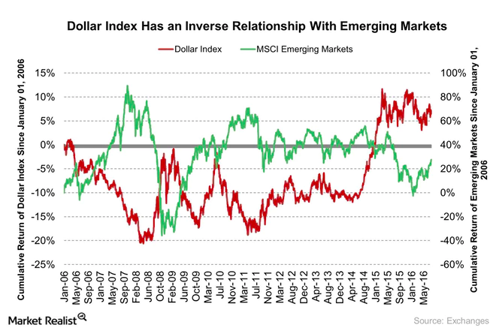
A Stronger Dollar Is Negative For Emerging Markets
http://marketrealist.com/2016/10/risks-emerging-market-rising/

Slide 31
You Must Decide Which Currency Risks To Manage
Use offsetting transactions
Use futures contracts and options.

Slide 32
Liquidity Risk
The risks associated with buying and selling emerging market securities.
This risk is expected to be higher than in developed markets, due to the small trading float.
Even small trades can result in large price fluctuations.
Investors may end up overpaying when buying securities or taking a hit when they sell.
Transaction costs (the difference between ask and beat may be high).
Some securities may not even trade for days (e.g., Greek market in 1991).

Slide 33
Another Definition of An Emerging Market
“An emerging market is a market from which you cannot emerge in an emergency.”
- Christopher Fildes

Slide 34
What’s Company Risk
Any risk of losses arising from exposure to a particular corporation.
A big revenue or profit miss.
The departure/death of a legendary leader.
A fine (e.g., Qualcomm in China)
Major tax liability (Apple and Google in EU).
Accounting irregularity (ENRON, Computer Associates).
Nationalization (eg., Corimon)

Slide 35
What’s Broker Risk
The losses associated with unscrupulous brokers
Front running
Unauthorized trading and churning
In 1993, Rogue Trader Nick Leeson in Singapore brought down the Barings Bank.
Placed wrong bet on the derivatives market.

Slide 36
What’s Custodial Risk
Exposure to local safekeeping (custodial) agents like theft or damage.
Exposure to the failure of a counterparty to deliver securities
Due to insufficient funds.
Counterparty risk is high for derivative products.
Risk is limited with mark-to-market.

Slide 37
What’s Settlement Risk?
Problems associated in transferring, registering, and getting paid for securities.
Capital controls can make it difficult to settle cross-border trades (e.g., Greece).

Slide 38
What’s Operational Risk
Problems arising from inadequate auditing and bookkeeping standards, computer glitches, hacking, and power outages (e.g., Puerto Rico after Maria).
Frequent strikes and protests that can interrupt one or more of the company’s operations (e.g., a strike by port workers).

Slide 39
What’s Market Risk?
Exposure to extreme market fluctuations.
It could be caused by a sharp increase in interest rates, also known as Interest Rate Risk.
It could include one asset category (e.g., 1987, 2000-1 or several asset categories (e.g.2008-9 crash).

Slide 40
Systemic Risk Can Be Caused By
A rise in interest rates in the countries that provide the funds for “carry trades,” US, Japan, EU.
A “Black Swan” credit event, e.g., Lehman Brothers.

Slide 41
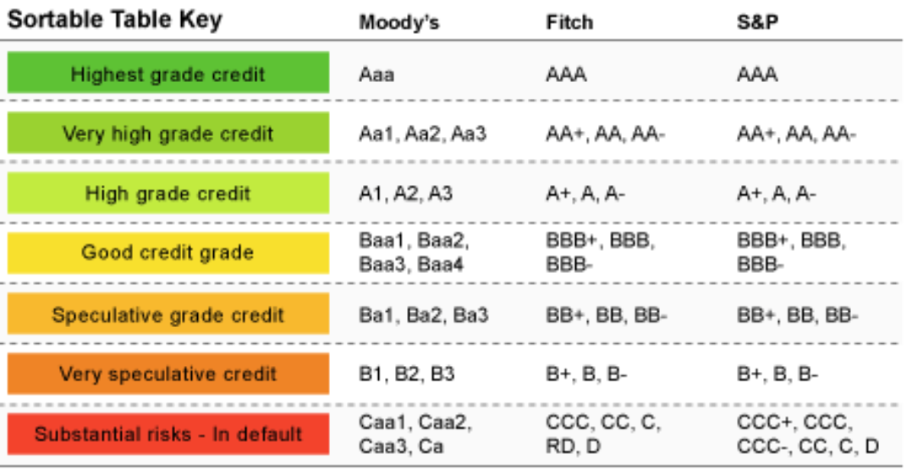
Credit Agency Risk Rankings

Slide 42
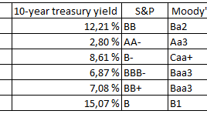
Debt Grading And 10-year Treasury Bond Yield For Selected Countries
Tradingeconomics.com

